Slide 1
PROJECT TITLE:Responsive portfolio website
AUTHOR: M.Dharshini
COURSE:Bsc.Computer science
DATE: 04.09.2025

Slide 2
PROBLEM STATEMENT
Need for a personal portfolio to showcase skills and projects.
Lack of a simple and interactive platform for self-presentation.
Requirement of a responsive and visually appealing design.

Slide 3
PROJECT OVERVIEW
A portfolio website created using HTML, CSS, and JavaScript.
Provides information about skills, projects, and personal profile.
Includes interactive UI with background color change and animations

Slide 4
END USERS
Students → showcase academic projects.
Job Seekers → highlight skills for recruiters.
Freelancers → present portfolio to potential clients.
Developers/Designers → share personal profile online.

Slide 5
TOOLS AND TECHNIQUES
HTML5 → structure of the website.
CSS3 → styling and transitions.
JavaScript → interactive features (background color change).
VS Code / Any IDE → development environment.
Web Browser → execution & testing.

Slide 6
PORTFOLIO DESIGN AND LAYOUT
Header Section → Name, title, and introduction.
About Section → Personal details and description.
Project/Work Section → Showcase of work.

Slide 7
FEATURES AND FUNCTIONALITIES
Clean and simple UI/UX design.
CSS transitions for smooth hover effects.
JavaScript background color changer.

Slide 8
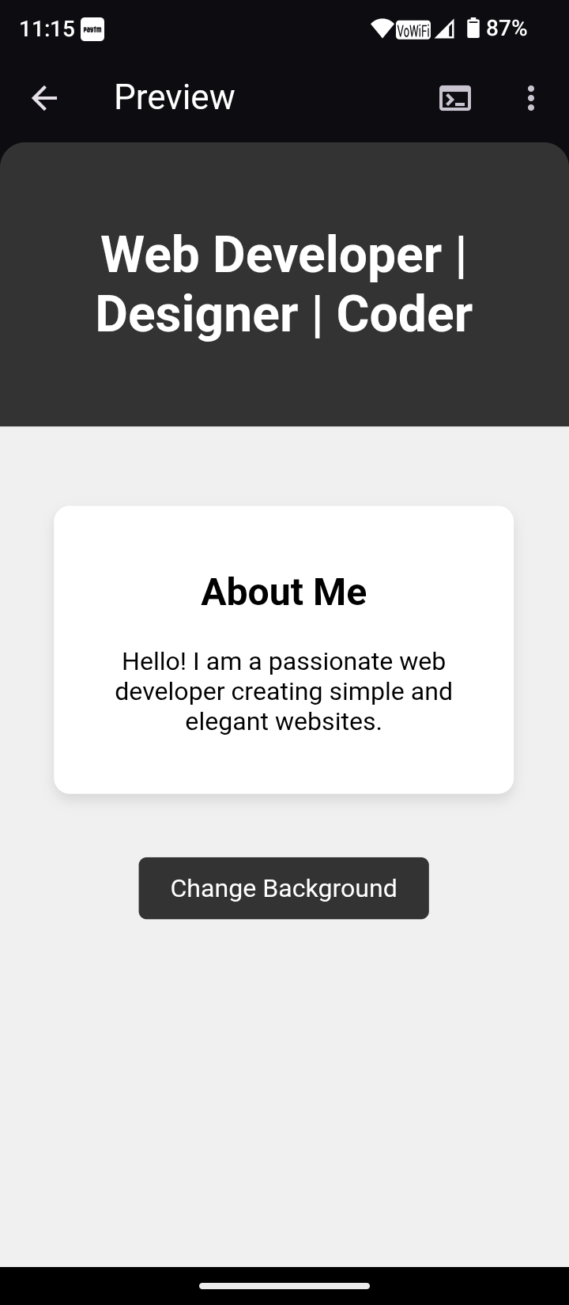
RESULT AND SCREENSHOTS

Slide 9
CONCLUSION
Built a simple yet functional portfolio website.
Demonstrated use of HTML, CSS, JavaScript together.
Useful for students, professionals, and freelancers

